Slide 1
Tableau Assignments

Slide 2
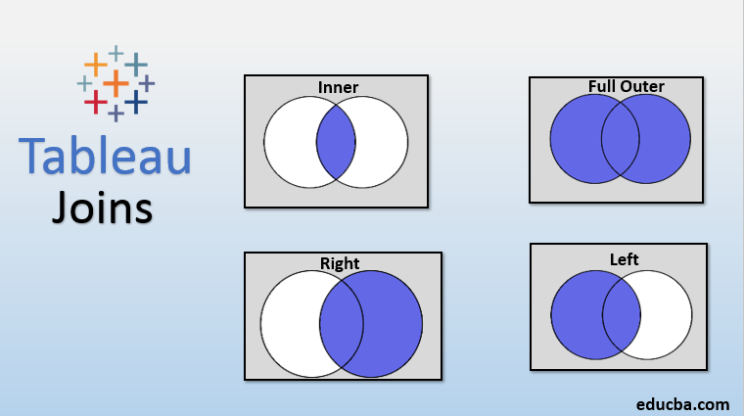
What types of joins are supported by tableau
There are 4 types of joins
Inner join
Left
Right
Full outer join

Slide 3
What is the difference between tableau public and tableau desktop
Tableau public :
It is the free version that doesn't connect to as many data sources as the personal or professional versions, but it's more than capable for most work. It can read data from text (CSV) files and Excel files which you'll be using in this course. Also, you can't save to workbooks on your computer, but instead, save to a public workbook.
Tableau desktop :
It is the paid version which is provided by Udacity to its learners of Nanodegree programs free of charge, which allows you to save locally and work with more data sources and save the files on a local server.

Slide 4
What are the different types of connections are provided by tableau
Tableau provides 2 types of connections
Live
Extract

Slide 5
Live connection
There is direct connection with the data present in the data source.
Advantage:
We will always get the latest data into the workbook automatically, while we are interacting with the workbook, or every time we reload the dashboard
Disadvantage:
Performance might be slow, as there is going to be network dependency and the performance of the data source will determine the performance of tableau.

Slide 6
Extract connection
This is where we fetch copy of the data from the data source and save it locally (either on the local machine or a shared folder in a drive) and access the data from there.
Advantage:
We get off-line access to the data, and as we would be accessing the data from our own machine or folder on the intranet, the performance will be better than live connection.
Disadvantage:
No live data. As we would be working with the data that has been extracted in the past, we may miss out on the latest updates to the data.

Slide 7
Explain each type of connection
Live:
If the dataset is too large and if it resides in remote place and data is updating every minute or every hour or every day. In that case it is not possible to copy that data into local system and work on that.
In that case tableau has provided us with the option called live connection. Under live connection we connect to that particular dataset and we work on that particular dynamic dataset from our tableau desktop

Slide 8
Extract:
Extract is basically copying that particular dataset in our local system and working on that particular dataset from the tableau desktop.
For extract connection we have the ability to copy that data and work around that data and working around on reports and dashboards.

